Slide 1

CHURN PREDICTION ANALYSIS
Using machine learning to build models to predict Customer Churn
Notes:
Hello everyone. Today, I'm excited to present my work on 'Churn Prediction Analysis,' focusing on how we can leverage machine learning to build models that accurately predict customer churn. This is a critical area for any business, especially in competitive industries, as retaining existing customers is often more cost-effective than acquiring new ones.

Slide 2

SPEAKER INTRODUCTION
BARATH ANANDARAMAN
Principle Engineer II, Charter Communications
20 Years of working experience in Telecom Industry. Currently focusing to enhance customer satisfaction and drive business growth through innovative strategies.
2
Notes:
Before we dive into the details, a brief introduction. My name is Barath Anandaraman, and I am a Principle Engineer II at Charter Communications. I bring 20 years of experience from the Telecom Industry, and my current focus is on enhancing customer satisfaction and driving business growth through innovative strategies, which directly relates to the importance of understanding and predicting customer churn.

Slide 3

WHAT IS A CUSTOMER-CHURN?
Definition
Churn refers to the rate at which customers stop using the services and move to a competitor.
Importance and Need
Customer acquisition is expensive
Improve service offerings based on customer needs
Focused marketing campaigns
Increased revenue and profitability
3
Notes:
So, what exactly is customer churn? Simply put, churn refers to the rate at which customers stop using a service and move to a competitor. It's a fundamental metric that reflects customer loyalty and satisfaction
Why is it so important? The reasons are compelling and directly impact a company's bottom line
Firstly, customer acquisition is significantly more expensive than retention. It takes substantial resources to attract new customers, so losing existing ones represents a direct loss on that investment.
Secondly, by understanding why customers churn, we can improve our service offerings to better meet customer needs. This leads to a more robust and desirable product or service.
Thirdly, churn prediction enables us to launch focused marketing campaigns. Instead of broad, generic campaigns, we can tailor our efforts to at-risk customers with specific interventions.
Ultimately, reducing churn directly contributes to increased revenue and profitability. Retaining customers means a more stable and growing customer base.

Slide 4
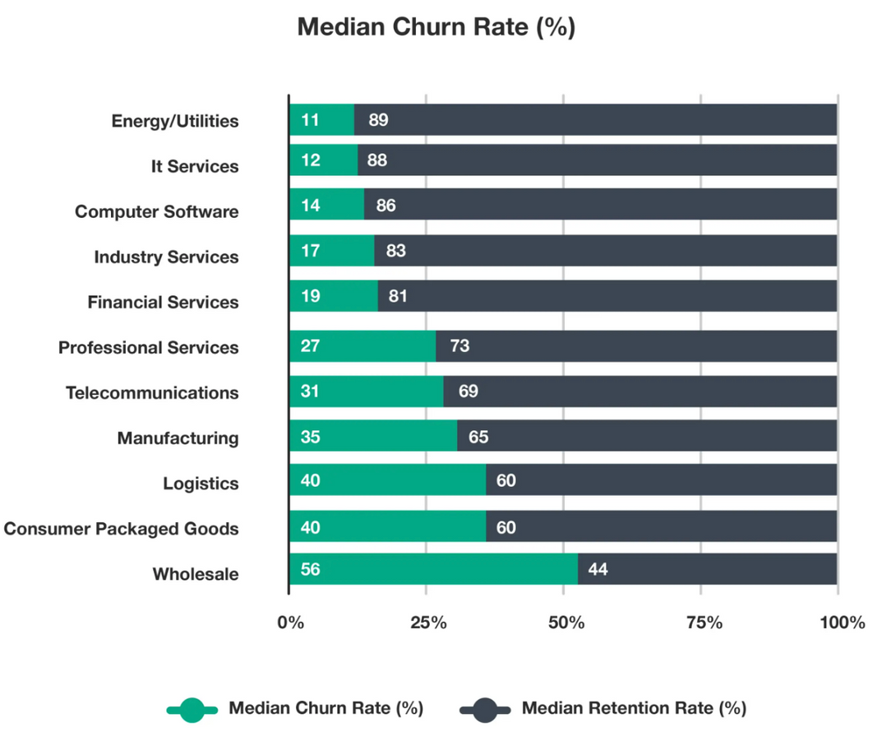
WHY CUSTOMER-CHURN MATTERS
TELECOMMUNICATION COMPANIES HAVE 31% CHURN RATE
Customer-churn is crucial for a successful business. Statistics show that companies working directly with customers have about and over 30% churn rate.
Our task is to predict who is likely to churn using machine learning
4
SOURCE: HTTPS://CUSTOMERGAUGE.COM/BLOG/AVERAGE-CHURN-RATE-BY-INDUSTRY
Notes:
To put the importance of churn into perspective, let's look at some industry statistics. This chart from customerGauge illustrates median churn rates across various industries. You can see that telecommunication companies, our focus for this analysis, have a median churn rate of 31%. This means almost a third of their customer base turns over annually. This high churn rate underscores why customer churn is crucial for a successful business, especially in the telecom sector. Our goal, then, is to predict which customers are likely to churn using machine learning, allowing us to proactively intervene a likely churn.

Slide 5
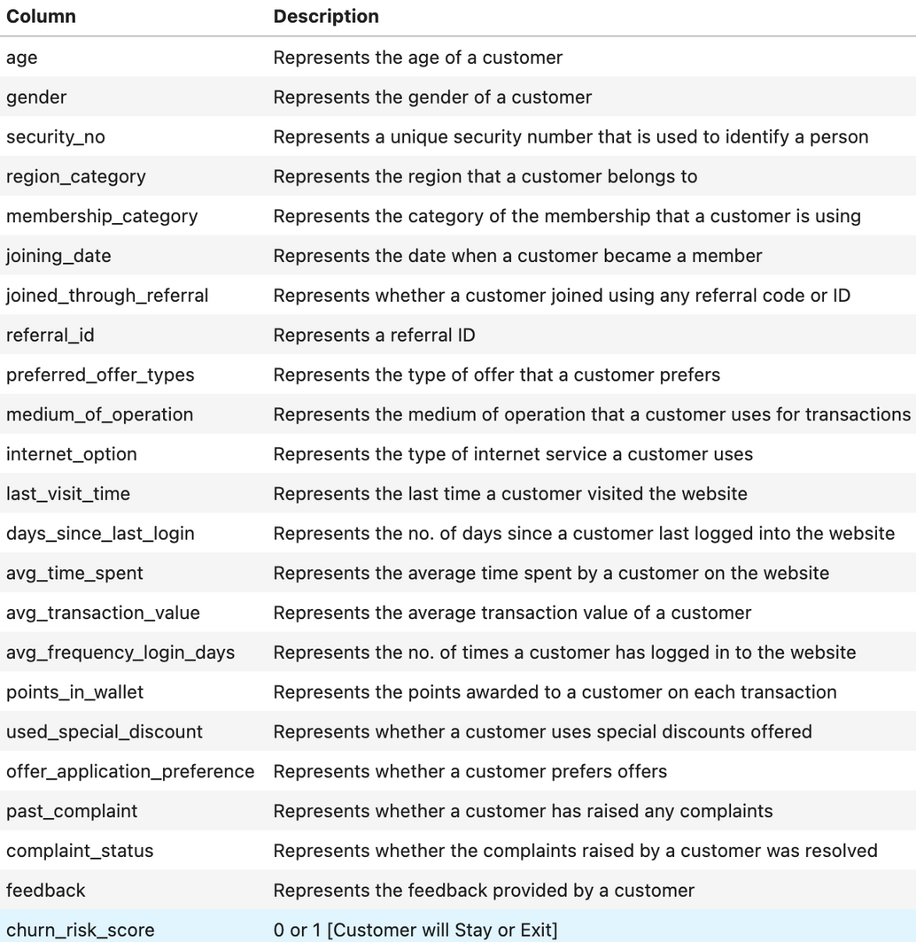
DATASET OVERVIEW
The dataset selected originates from a HackerEarth (Heena, 2021) website
It contains 36,992 rows and 24 variables, covering customer demographics, service usage, complaints, feedback etc.
The target variable churn_risk_score is binary (0 = low risk, 1 = high risk)
5
Notes:
The analysis is built upon a robust dataset originating from a HackerEarth website. This dataset is quite comprehensive, containing 36,992 rows and 24 variables. These variables cover a wide range of customer information, including demographics, service usage patterns, complaint history, and even customer feedback
The key element for our prediction task is the target variable, 'churn_risk_score,' which is binary: '0' indicating a low risk (customer will stay) and '1' indicating a high risk (customer will exit).
The table on this slide provides a detailed overview of each column, from 'age' and 'gender' to 'membership_category,' 'internet_option,' 'average time spent,' and crucial indicators like 'past_complaint' and 'feedback'

Slide 6
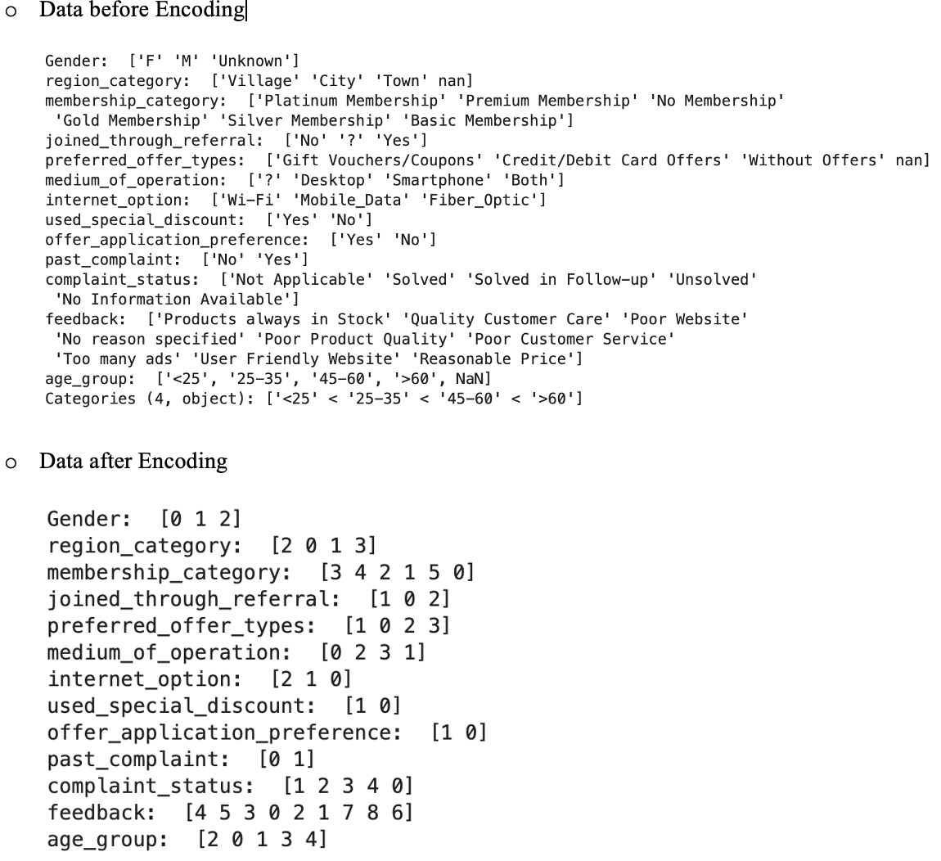
DATA PREPARATION
Dropped non informative columns (security_no, referral_id, joining_date, etc.)
Converted object to numeric for columns that are expected to be numeric like avg_frequency_login_days
Impute missing numeric values with the columns mean
Encode categorical variables using Label Encoder
6
Notes:
Effective data preparation is fundamental for any machine learning project. I undertook several steps to clean and transform our raw data.
First, I dropped non-informative columns such as 'security_no', 'referral_id', and 'joining_date'. These columns were deemed to have little predictive power for churn.
Next, I converted object-type columns that contained numerical data, like 'avg_frequency_login_days,' into their proper numeric format.
For missing numeric values, I employed a common imputation strategy: filling them with the mean of their respective columns.
Finally, I encoded categorical variables using Label Encoder. This is crucial for machine learning models, as they require numerical input. You can see the 'Data before Encoding' section showing examples like 'Gender' with 'F', 'M', 'Unknown,' and then 'Data after Encoding' converting these to numerical representations like [0 1 2].

Slide 7
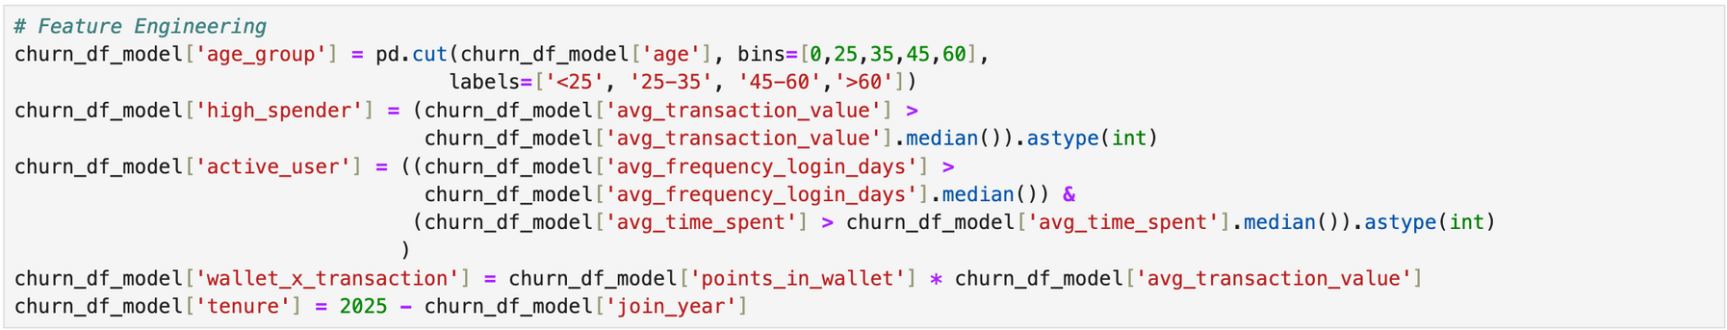
FEATURE ENGINEERING
age_group binning by age groups
high_spender with avg_transaction_value above its mean
active_user based avg_frequency_login_days that is above its mean
Tenure based on number of years from 2025
wallet_x_transaction with points_in_wallet times avg_transaction_value
7
Notes:
Beyond basic data preparation, I engaged in feature engineering to create new variables that could enhance our model's predictive power.
I created 'age_group' by binning ages into distinct categories like '<25', '25-35', '45-60', and '>60'. This helps capture non-linear relationships with age.
'high_spender' was engineered to identify customers whose 'avg_transaction_value' was above the median.
'active_user' was defined for customers whose 'avg_frequency_login_days' and 'avg_time_spent' were both above their respective medians. This helps identify truly engaged users.
I calculated 'tenure' based on the number of years from 2025 relative to the customer's 'join_year'. Longer tenure often indicates higher loyalty.
Lastly, 'wallet_x_transaction' was created by multiplying 'points_in_wallet' by 'avg_transaction_value'.
This composite feature aims to capture the combined impact of loyalty points and transaction value

Slide 8
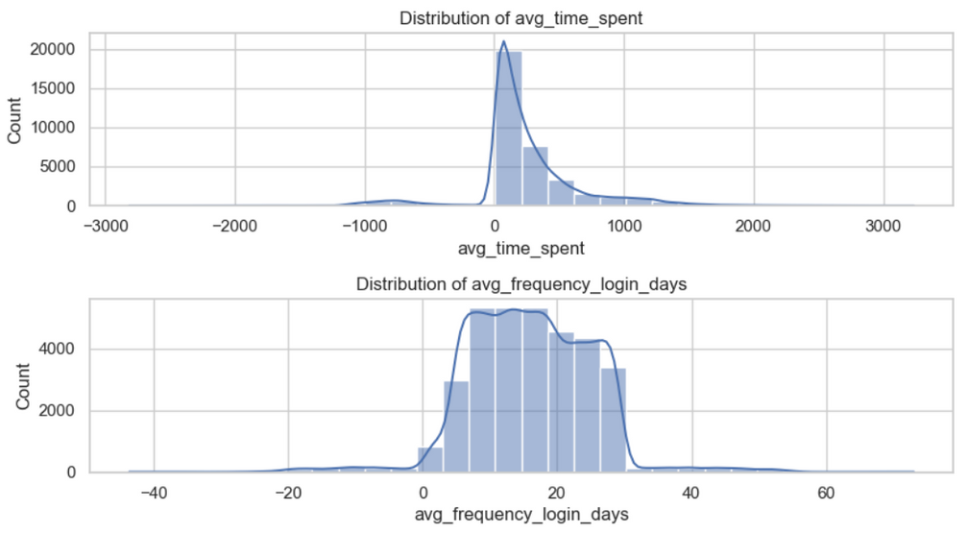
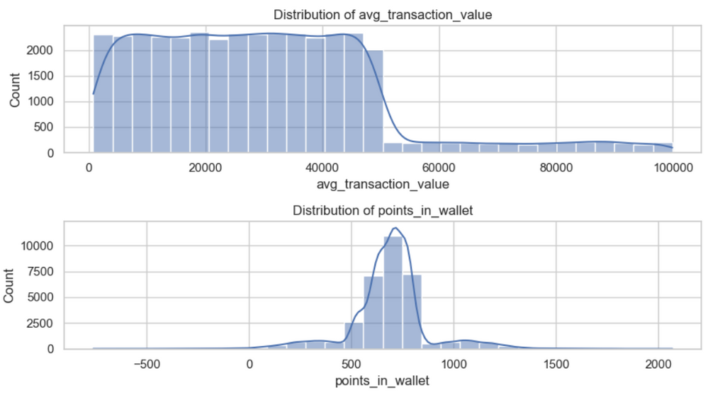
EXPLORATORY DATA ANALYSIS
HISTOGRAM
avg_time_spent right skewed but has negative values.
avg_transaction_value, right skewed with possible outliers.
avg_frequency_login_days also has negative values
points_in_wallet bell shaped with some outliers
8
Notes:
Moving into Exploratory Data Analysis, these histograms provide insights into the distribution of key numeric features.
avg_time_spent, avg_transaction_value are right skewed.
avg_frequency_login_days, avg_time_spent has negative values, which was addressed during data preparation
points_in_wallet bell shaped with some outliers
These observations are crucial for understanding data characteristics and potential transformations needed

Slide 9
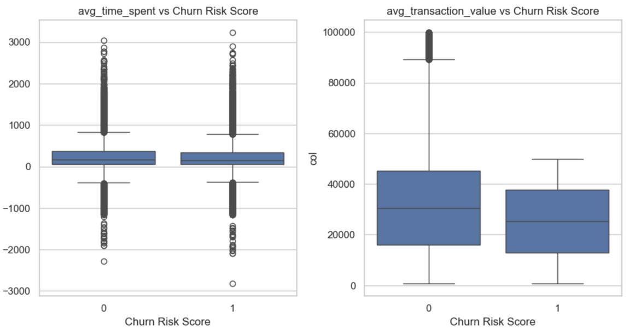
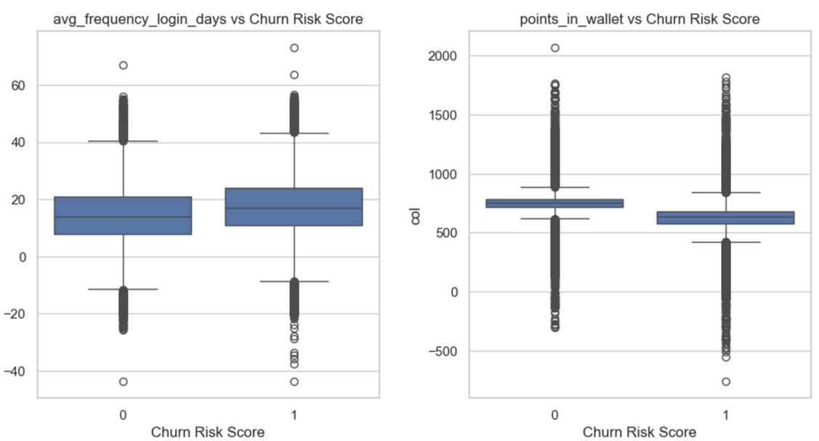
EXPLORATORY DATA ANALYSIS
BOX PLOT
avg_transaction_value tend to decrease as churn risk increases
avg_frequency_login_days tend to increase as churn risk increases
points_in_wallet tend to decrease as churn risk increases
9
Notes:
These box plots illustrate the relationship between our key numerical features and the 'churn_risk_score.'
Observe that 'avg_transaction_value' tends to decrease as churn risk increases. This suggests that customers spending less might be at higher risk of churning.
Conversely, 'avg_frequency_login_days' tends to increase with churn risk. This might seem counter-intuitive but could indicate that some churners are frequently logging in perhaps to resolve issues before leaving.
Finally, 'points_in_wallet' tends to decrease as churn risk increases. This aligns with expectations, as customers with fewer loyalty points might feel less incentivized to stay.

Slide 10
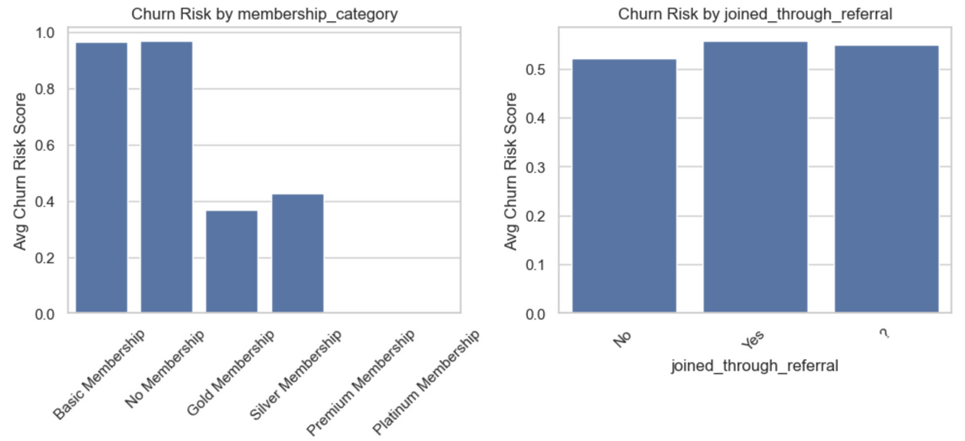
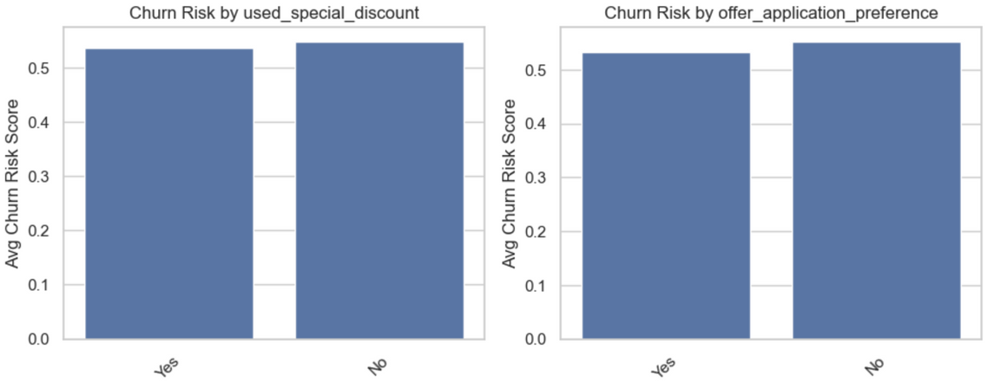
EXPLORATORY DATA ANALYSIS
BAR PLOT
membership_category: Customers with No/ basic Membership show higher churn risk on average.
Customers who did not use discounts have slightly higher churn.
offer_application_preference, those who do not prefer offers churn more.
Higher complaint history tends to churn more.
10
Notes:
These bar plots highlight the average churn risk across different categorical variables.
For 'membership_category,' customers with ‘Basic/ No Membership' show a significantly higher average churn risk. This indicates that membership programs play a vital role in retention.
Customers who did not utilize special discounts have a slightly higher churn rate, underscoring the importance of promotional offers.
Similarly, those who do not prefer offers tend to churn more.
Lastly, our analysis showed that customers with a higher complaint history tend to churn more, emphasizing the need for effective complaint resolution

Slide 11
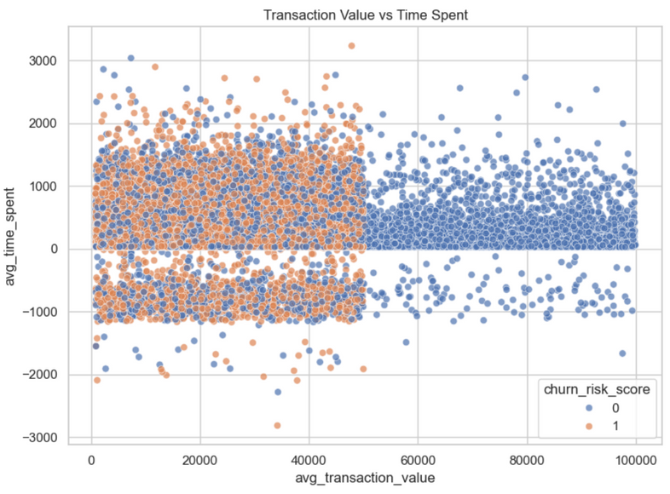
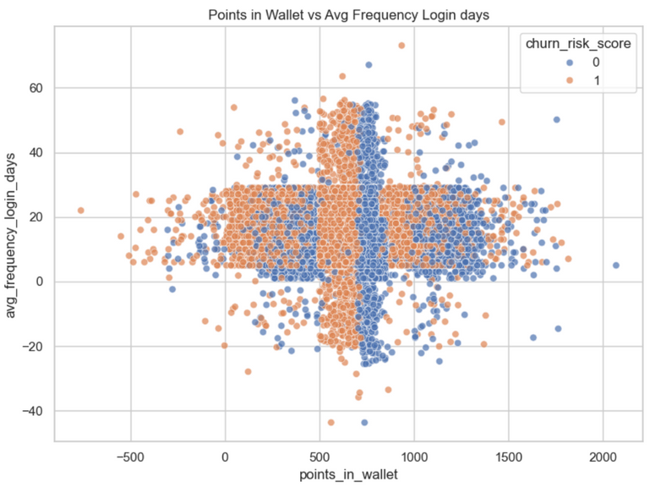
EXPLORATORY DATA ANALYSIS
SCATTER PLOT
avg_transaction_value tend to decrease as churn risk increases
avg_frequency_login_days tend to increase as churn risk increases
points_in_wallet tend to decrease as churn risk increases
11
Notes:
These scatter plots visualize the relationships between pairs of features, with churn risk score overlaid.
The 'Transaction Value vs. Time Spent' plot further reinforces our observation that 'avg_transaction_value' tends to decrease as churn risk increases.
Similarly, 'Points In Wallet vs. Avg Frequency Login Days' shows that 'points_in_wallet' tends to decrease as churn risk increases, while 'avg_frequency_login_days' tends to increase as churn risk increases. These visualizations help us understand the interplay between these variables and their impact on churn

Slide 12
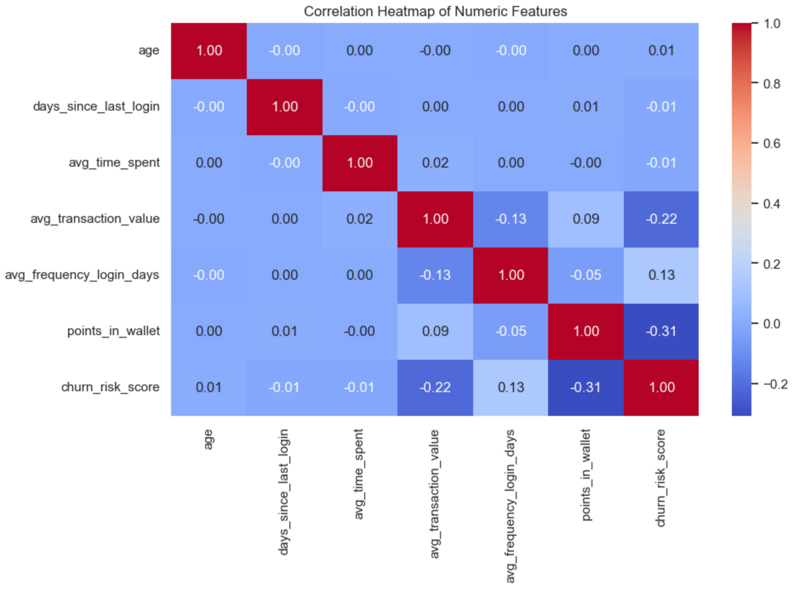
EXPLORATORY DATA ANALYSIS
CORRELATION MATRIX
avg_transaction_value tend to decrease as churn risk increases
avg_frequency_login_days tend to increase as churn risk increases
points_in_wallet tend to decrease as churn risk increases
12
Notes:
The correlation matrix provides a quantitative view of the linear relationships between our numerical features and the churn risk score.
This heatmap confirms our earlier observations from the box plots: 'avg_transaction_value' has a negative correlation with churn risk, meaning as transaction value decreases, churn risk increases.
'avg_frequency_login_days' shows a positive correlation with churn risk, suggesting that customers logging in more frequently might still be at risk.
'points_in_wallet' has a negative correlation, indicating that fewer points are associated with higher churn risk. This matrix helps us identify features that are strongly related to our target variable.

Slide 13


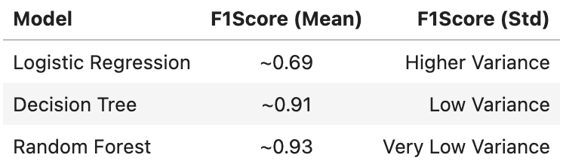
MODELING APPROACHES
Logistic Regression
Decision Tree
Random Forest
Used 5-fold cross-validation to assess model robustness and generalization using F1 Score
13
Notes:
We trained three models: Logistic Regression for baseline interpretability, Decision Tree for
rule-based patterns, and Random Forest for accuracy and robustness.
5 fold Cross-validation was
used to ensure consistency and avoid overfitting, and evaluated their performance primarily using the F1 Score.
Random Forest consistently outperformed the others across all folds, with very low variance, indicating its superior stability and predictive power.
Logistic Regression underperformed, with higher variance.

Slide 14
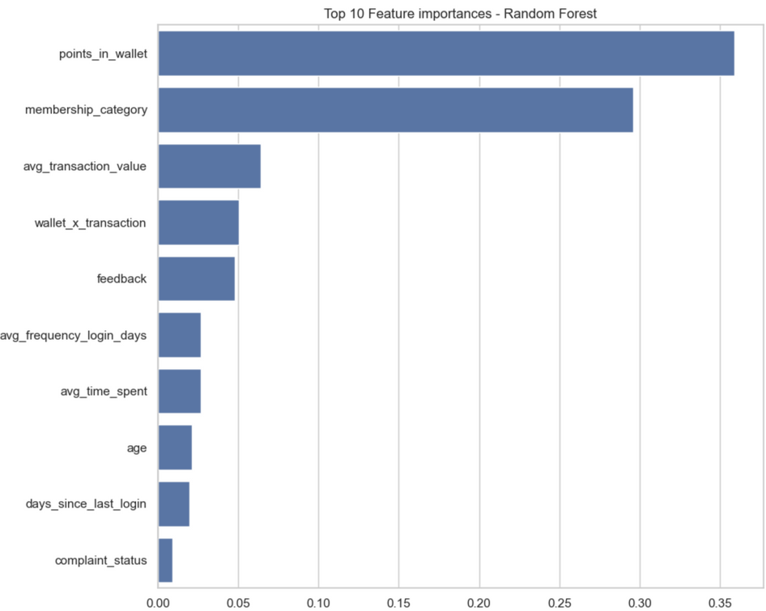
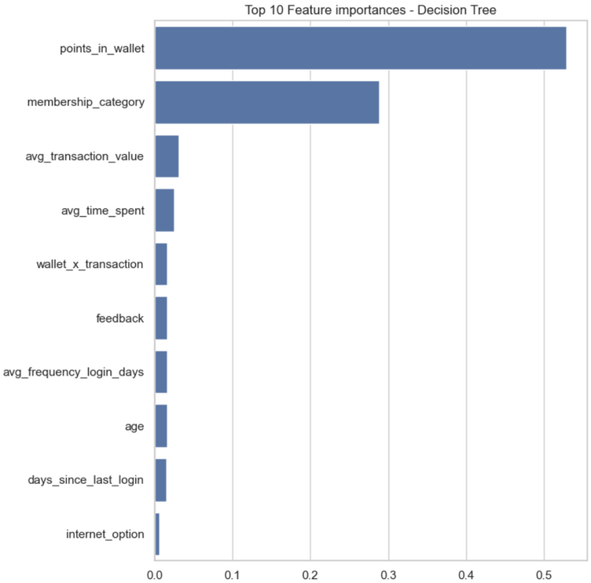
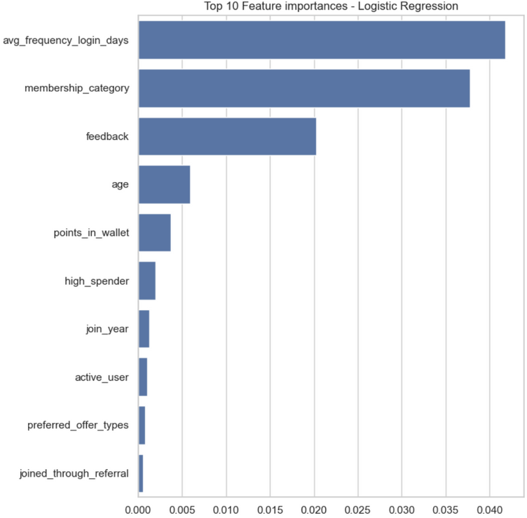
FEATURE IMPORTANCE
RANDOM FOREST
DECISION TREE
LOGISTIC REGRESSION
Random Forest and Decision Tree has points_in_wallet, membership_category and avg_transaction_value as the Top 3 features of importance.
Logistic Regression has avg_frequency_login_days, membership_category and feedback as the Top 3 features of importance
14
Notes:
Understanding which features contribute most to the predictions is crucial for interpretability and actionable insights.
For both Random Forest and Decision Tree, the top three most important features were 'points_in_wallet,' 'membership_category,' and 'avg_transaction_value'. This highlights the significant role of loyalty programs, membership tiers, and spending habits in predicting churn.
Logistic Regression, however, identified a slightly different set of top three features: 'avg_frequency_login_days,' 'membership_category,' and 'feedback'. This difference can be attributed to the linear nature of Logistic Regression compared to the tree-based models

Slide 15
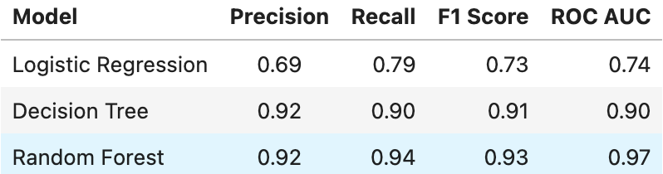
EVALUATION METRICS
Evaluated models using Precision, Recall, F1Score
Random Forest: Excellent across all metrics, particularly Recall (0.94) and ROC AUC (0.97), it is very good at correctly identifying churners
Logistic Regression: Lower recall suggests many true churners are being missed
15
Notes:
Beyond F1 Score, I further evaluated our models using Precision, Recall, and ROC AUC metric
Random Forest demonstrated excellent performance across all metrics, particularly with a high Recall of 0.94 and an ROC AUC of 0.97. This means it is very good at correctly identifying customers who are likely to churn.
Decision Tree also performed well, with a Recall of 0.90 and an ROC AUC of 0.90.
Logistic Regression, on the other hand, had a lower recall of 0.79, suggesting that it missed a significant number of true churners

Slide 16
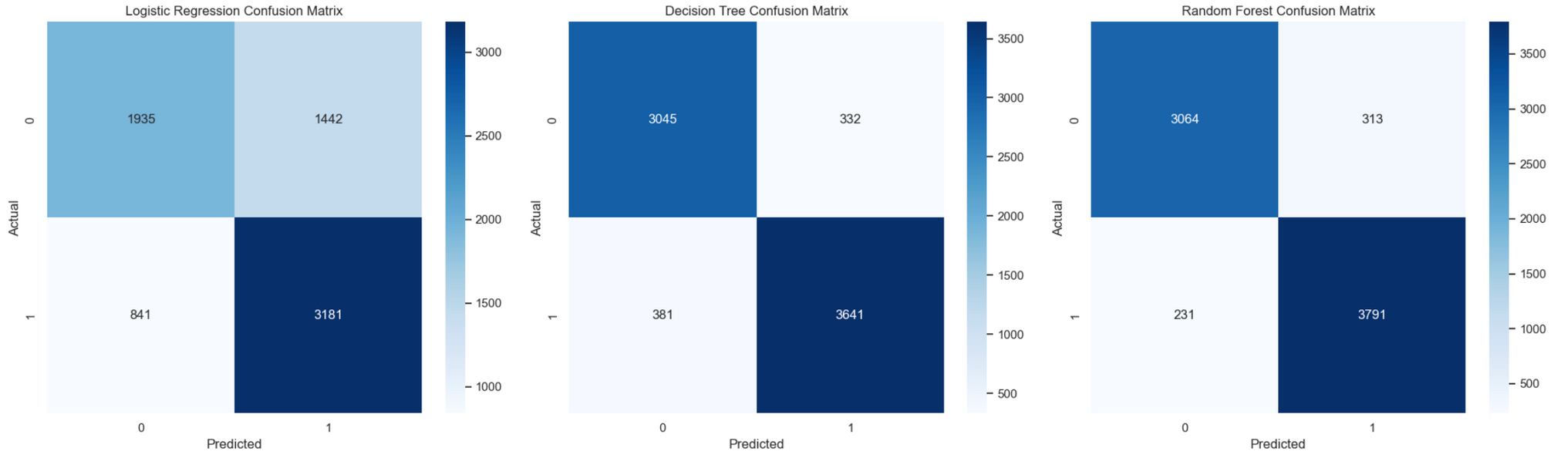
CONFUSION MATRIX
Random Forest and Decision Tree had strong diagonals - they correctly predicted most churn vs non-churn cases
Logistic Regression misclassified a larger number of churn cases (low recall)
Random Forest minimized false negatives – critical in churn prediction, where missing a churner is costlier than flagging a loyal customer
16
Notes:
The confusion matrices visually represent our models' performance in classifying churners versus non-churners.
Random Forest and Decision Tree show strong diagonals, indicating that they correctly predicted most churn and non-churn cases.
Logistic Regression, however, misclassified a larger number of churn cases, which is reflected in its lower recall score.
Crucially, Random Forest minimized false negatives, which is a critical aspect in churn prediction. Missing a churner (a false negative) is often more costly than incorrectly flagging a loyal customer (a false positive)

Slide 17
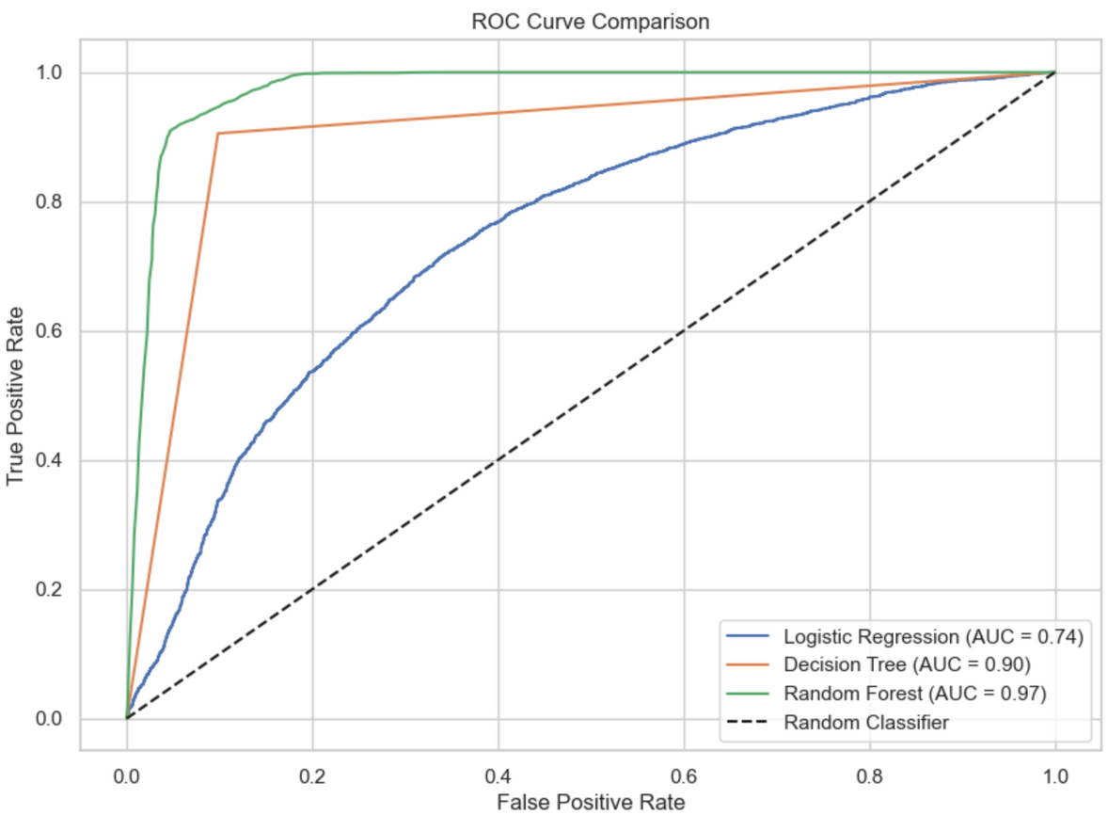
ROC AUC CURVE COMPARISON
Random Forest's curve hugged the top-left indicating excellent discrimination ability
Decision Tree performed well, but slightly under Random Forest
Logistic Regression had a curve closer to diagonal, indicating weaker performance
Random Forest had the highest AUC and the most desirable ROC curve shape
17
Notes:
Visual comparison of the models' performance using ROC curves. The Area Under the Curve (AUC) is a key metric for evaluating binary classification models to discriminate between classes.
Random Forest's curve ideally 'hugged' the top-left corner, signifying excellent discrimination ability. Its AUC of 0.97 confirms its superior performance.
Decision Tree performed well, but its curve was slightly below that of Random Forest, with an AUC of 0.90.
Logistic Regression's curve was closer to the diagonal, indicating weaker overall performance and an AUC of 0.74. Random Forest clearly had the highest AUC and the most desirable ROC curve shape, confirming it as our best model

Slide 18

RECOMMENDATIONS
Launch a Wallet bonus campaign
Segment and Engage Based on Membership
Targeted Outreach Using Feedback
Real-Time Scoring dashboard
Address negative feedback
18
Notes:
Based on the analysis and the insights from the Random Forest model, I have several key recommendations to proactively address churn:
Launch a Wallet bonus campaign: Since 'points_in_wallet' was a key churn driver, incentivizing customers with bonus points can encourage engagement and retention.
Segment and Engage Based on Membership: Customers with 'No Membership' showed higher churn risk. Targeted campaigns to upgrade or offer benefits to these customers can improve retention.
Targeted Outreach Using Feedback: Given 'feedback' was an important feature, addressing negative feedback directly and proactively can improve customer satisfaction and reduce churn.
:Implementing a real timedashboard that provides real-time churn risk scores for customers allows for immediate intervention and personalized outreach.
Address negative feedback: Systematically analyzing and acting upon negative feedback is crucial to improving overall customer experience and preventing churn.

Slide 19

CONCLUSION
Random Forest model was most accurate
Key Churn drivers identified: Points_in_wallet, Membership_category, Avg_transaction_value and feedback
Model ready for deployment
19
Notes:
In conclusion, our churn prediction analysis yielded significant results. The Random Forest model proved to be the most accurate and robust for predicting customer churn. successfully identified key churn drivers, most notably 'points_in_wallet,' 'membership_category,' 'avg_transaction_value,' and 'feedback'. This model is now ready for deployment, offering a powerful tool to enable proactive customer retention strategies and drive business growth

Slide 20
REFERENCES
Syed, H. (2021). Predict the Churn Risk Rate. HackerEarth. https://www.hackerearth.com/problem/machine-learning/predict-the-churn-risk-rate-11-fb7a760d/
GeeksforGeeks. (2025, April 28). How to plot ROC curve in Python. GeeksForGeeks. https://www.geeksforgeeks.org/how-to-plot-roc-curve-in-python/
Tessitore, S. (2025, May 21). What’s the average churn rate by industry? CustomerGauge. https://customergauge.com/blog/average-churn-rate-by-industry
Notes:
Finally, I'd like to acknowledge the resources and datasets that made this project possible. You can find the references here for further reading.
Thank you for your time and attention

